Slide 1

STAT 5243 Project 5 – Text Mining to Optimize the Success of an Airbnb Listing
By: Max Karsok, Elena Dubova, Matthew Vitha

Slide 2

Agenda
Introduction – Problem Statement and Dataset
EDA
Stratifying Methodology
Analysis 1: Length and Density
Examples
Analysis 2: Topic Modeling
Analysis 3: TF-IDF
Analysis 4: Sentiment Analysis
Analysis 5: Polarity Analysis
Conclusion

Slide 3
Introduction
Dataset
Problem Statement
Dataset is comprised of ~30,000 Airbnb rentals in New York City.
Data set is 29.1k rows and 96 columns
All types of data entailing:
14 textual columns
Ratings
Spatial Data
Numeric data (i.e. price,reviews per month)
Date/Time Data
Is it possible to use text mining algorithms to determine the difference between ‘good’ and ’bad’ Airbnb listings?
Does textual structure of an Airbnb listing influence the success of that listing?
Notes:
The value of our recommendations is that they do not require any financial investment, but still might positively influence the profile of the host. For analysis we sampled listings from a dataset of ~30,000 observations; we used stratified sample to control for location and price range.

Slide 4

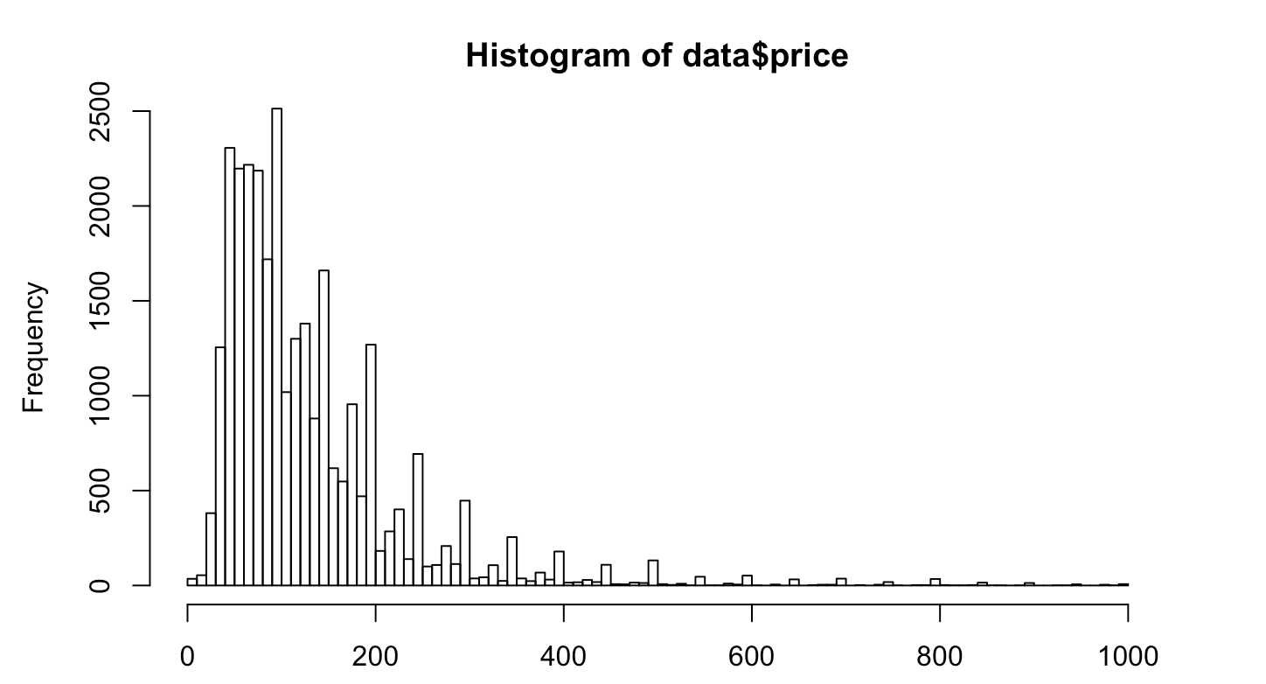
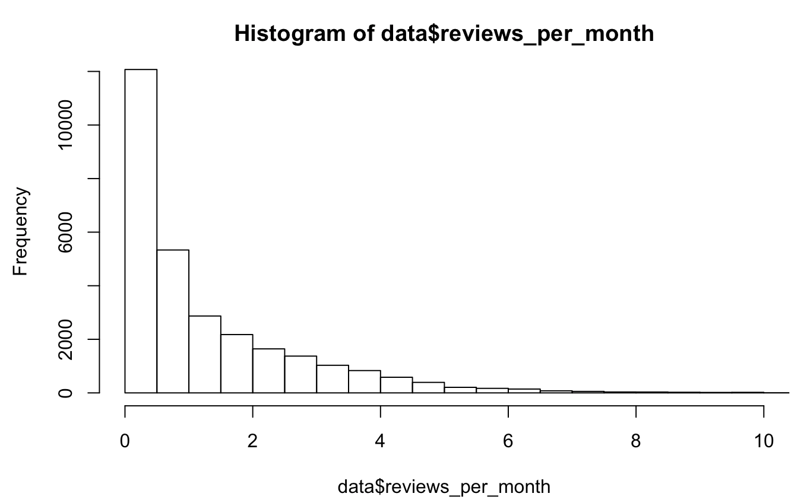
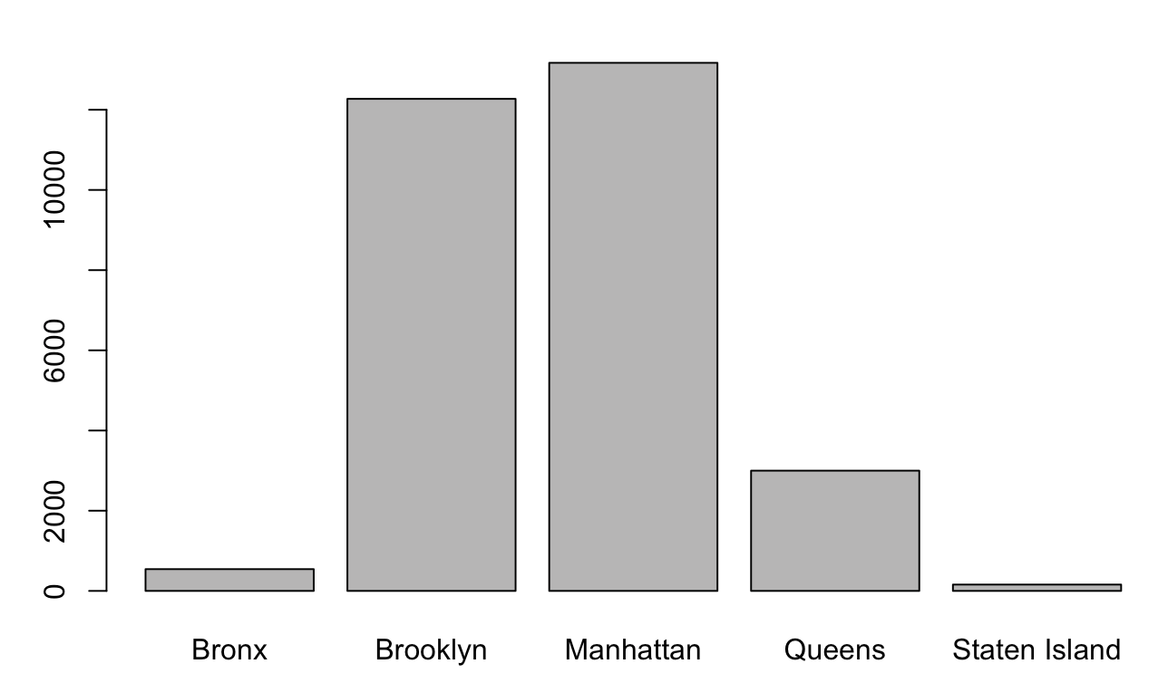
Exploratory Data Analysis
Before performing our analysis, we employed EDA to identify our correct performance variables.
Below shows the distribution of the ‘price’ ,‘reviews-per-month’, and ’borough’ variables
The price variable is right-skewed, with the long tail comprised of expensive listings.
The reviews-per-month variable is right skewed as well, where above 2 reviews-per-month is considered above average
Brooklyn and Manhattan are reasonable choices to limit to when placing controls over location.
Notes:
i.e. our variables are right skewed accoridng to these charts – which is why we strateify
To examine the difference between ‘good’ and ‘bad’ Airbnb listings, it was more efficient to create two polar samples that present the best and the worst listings rather than analyze all listings in the dataset

Slide 5
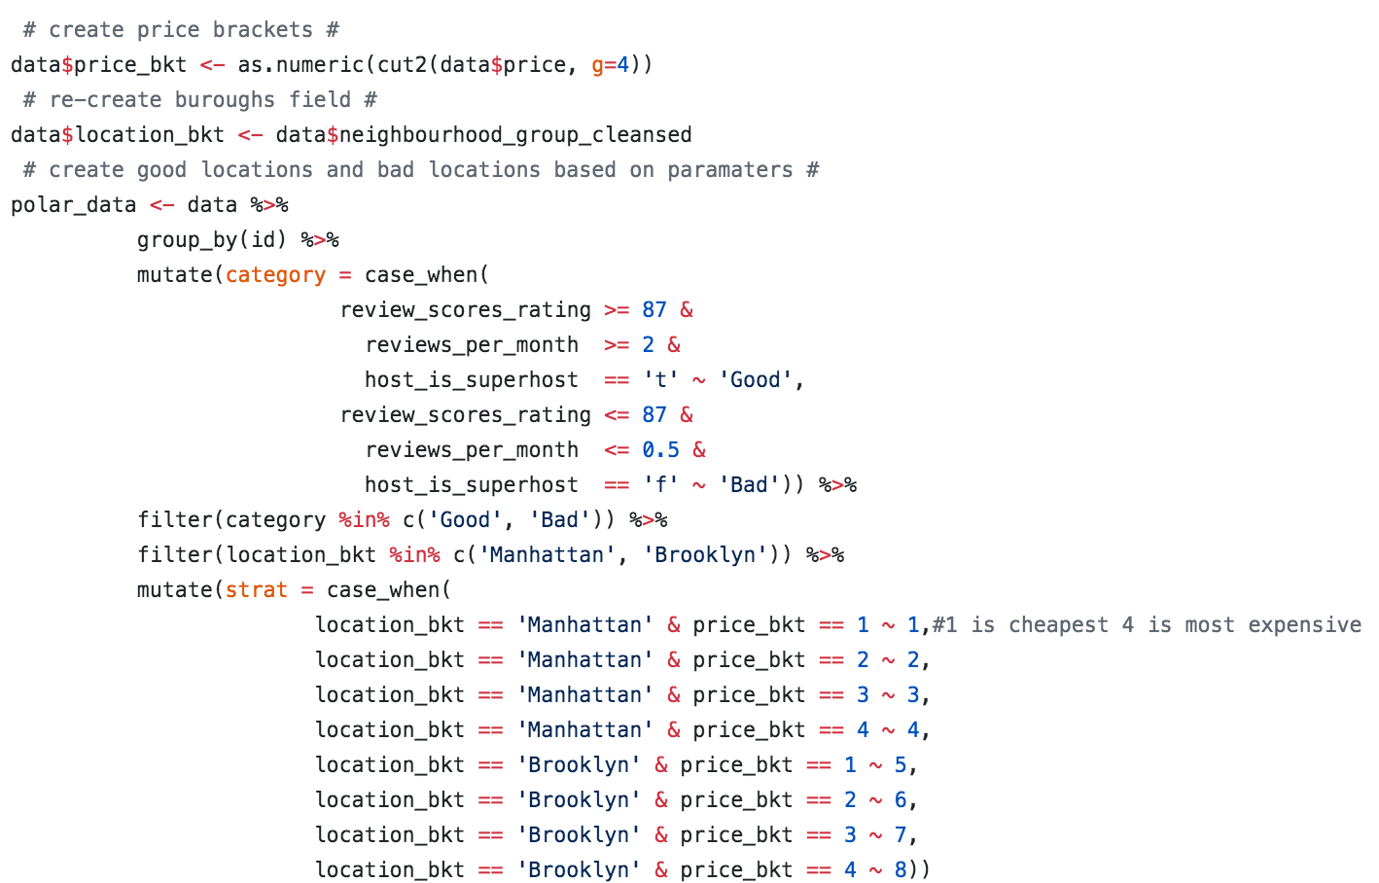
Methodology for Stratification of ’bad’ and ‘good’
More efficient to create two polar samples that present the best and the worst listings
Rather than analyze all ~30k listings in the dataset
To measure "goodness" of the listing we created a composite indicator that considers:
Review score ratings
Two measures of popularity (overall number of reviews and number of last month's reviews),
super host indicator
To reduce bias in the sample, we controlled for location and price bucket.
Notes:
“we sampled data into two polar categories – listings that we consider good and bad
Good Listings:
1. Review_score_rating >=87, reviews_per_month >=2, super_host = True
Bad Listings:
2. Review_score_rating <= 87m reviews_per_month <= 2, super_host = False
Strateified our listeings based on location and price (i.e. price grouped into quartiles, and mapped to either NYC or Brooklyn giving 8 different locaiton/price buckets
So 8 buckets for good listings, 8 buckets for bad listings
TWO REASONS FOR STRATIFICATION
Main – we want unbiased samples .. i.e. tellling that all poor listings are in queens isn’t helpful
Second – helpful breakdown

Slide 6

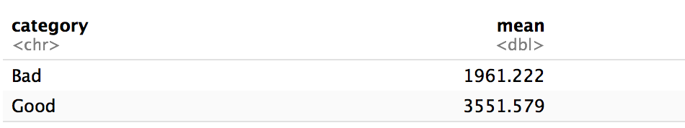
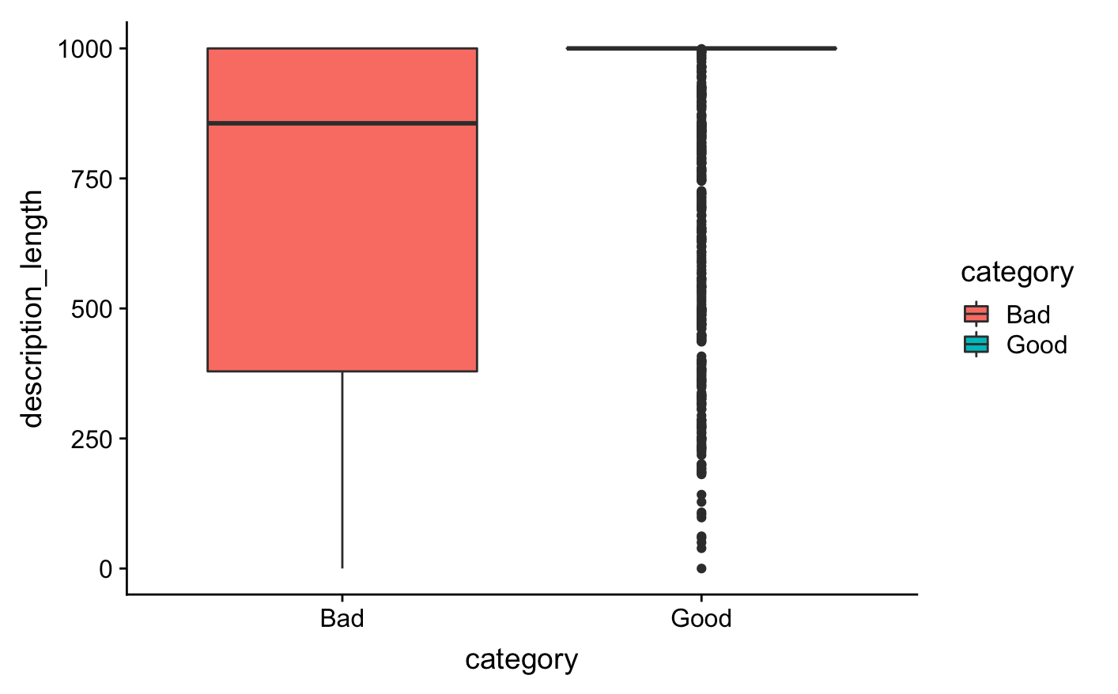
Analysis I: Difference in Lengths of ’Bad’ and ‘Good’ Listings
Textual Columns used to measure length of listing
Description
Summary
Space
Neighborhood Overview
Notes
Transit
Access
Interaction
House Rules
Host About
Notes:
On average, successful listings are longer and it is consistent throughout 8 strata of sample. To be more precise, we can compare means.
So, first free tip for a new host is to invest energy to write more text to describe the apartment.
The boxplot provides clear guidance on how to approach this particular mandatory category: to be successful one should make an effort to write exactly 1000 words.

Slide 7
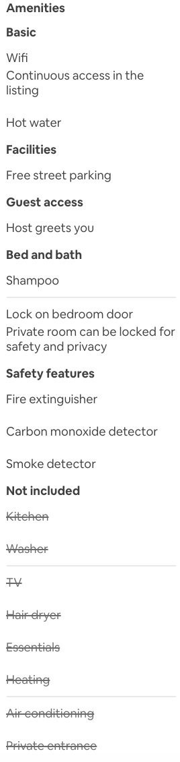
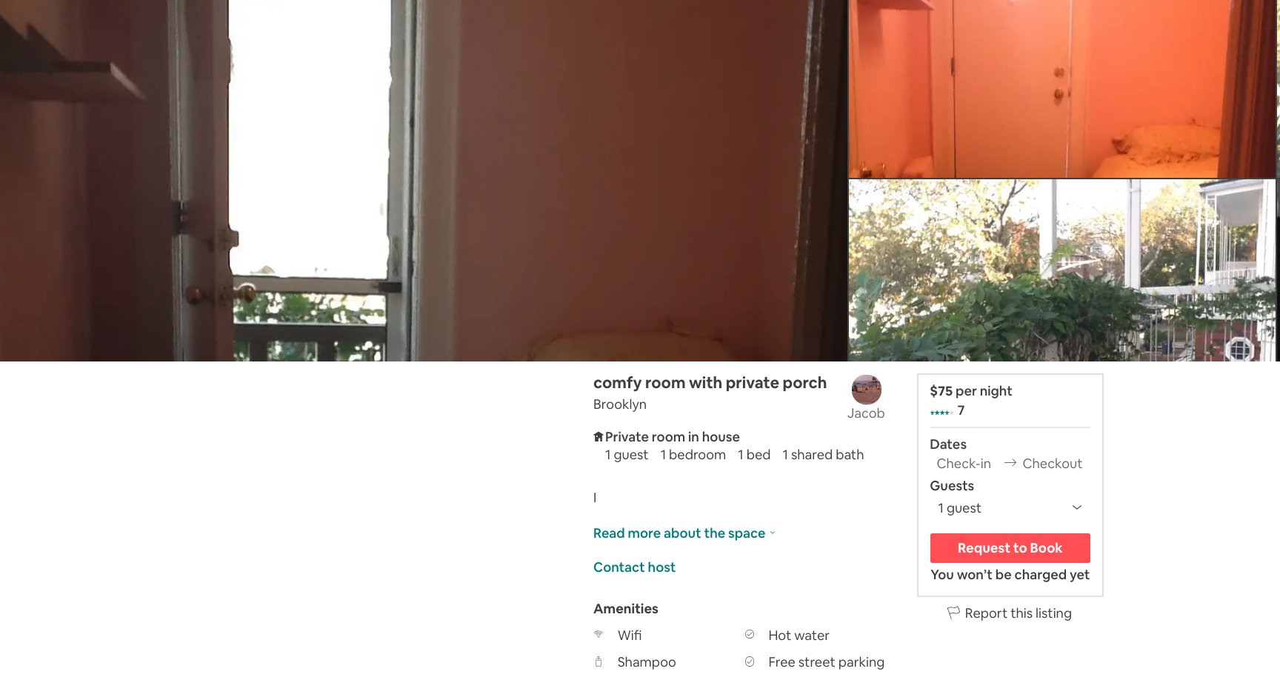
Example #2 – ‘Bad’ Listing
Notes:
***NOTE - no “about the space” description for this listing

Slide 8
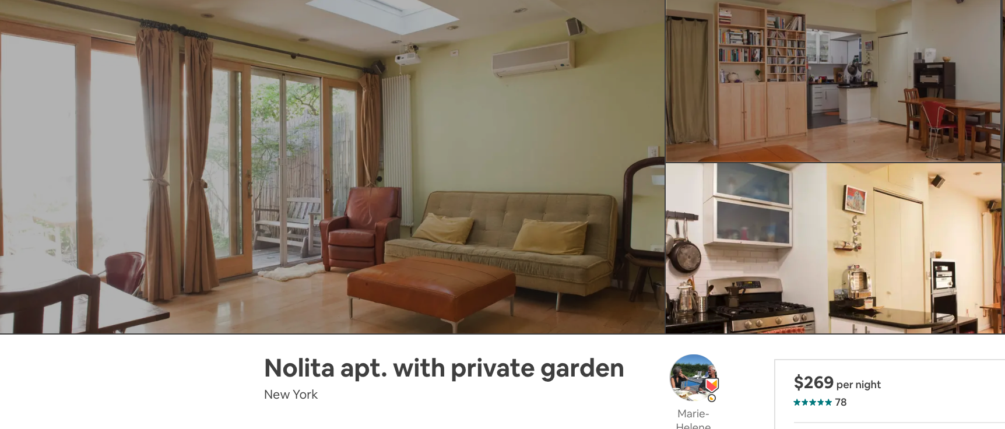
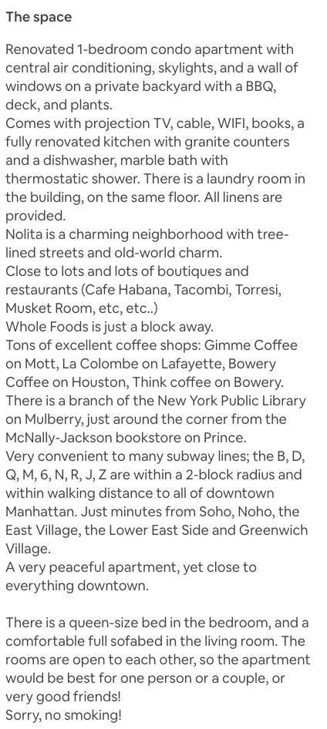
Example #1 – ‘Good’ Listing

Slide 9

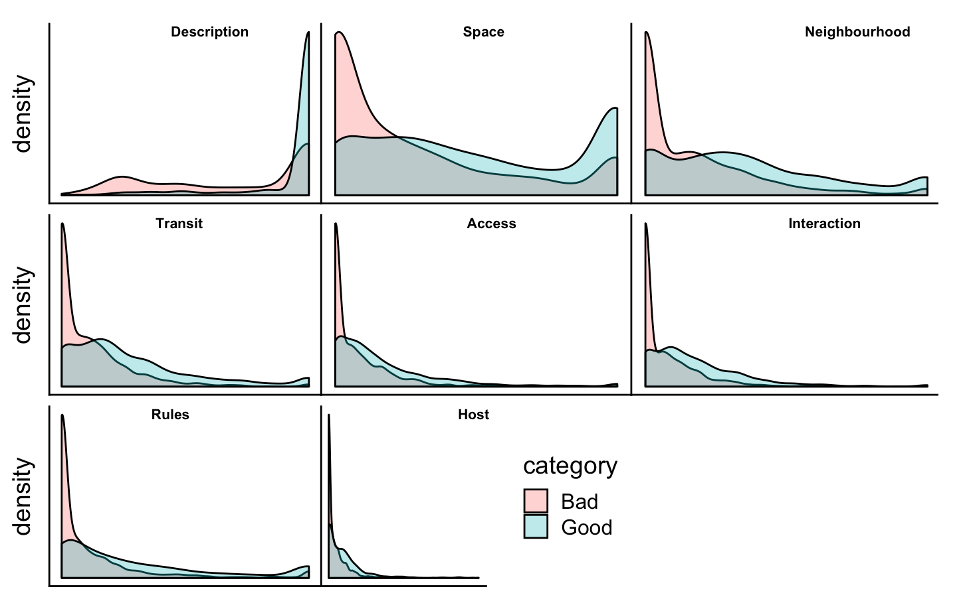
Analysis I: Density of Different Text Fields between ‘Bad’ and ‘Good’ Listings
Successful hosts are more verbose
Interestingly, both "good" and "bad" hosts often ignore description of themselves
Dichotomy for good and bad listings observing the mandatory field "description”
Notes:
Density plot shows patter better than histogram (more vivid pattern)
In all categories, succesful listings are longer
Description Is MANDATORY – is never 0. The rest are all optional. Those that don’t care, don’t fill in. But that isn’t true for the successful listings
i.e. neighborhood and transit
Unsuccessful listings tend to generate less text, especially considering the fields:
"space", "neighborhood", "transit", "access", "interaction" and "rules" categories.
2. Unsuccessful listings tend to generate less text, especially considering the fields:
"space", "neighborhood", "transit", "access", "interaction" and "rules" categories.
3. Dichotomy for good and bad listings observing the mandatory field "description": variance is pretty low for "good" listings, especially, comparing to high variance of "bad" listings.

Slide 10
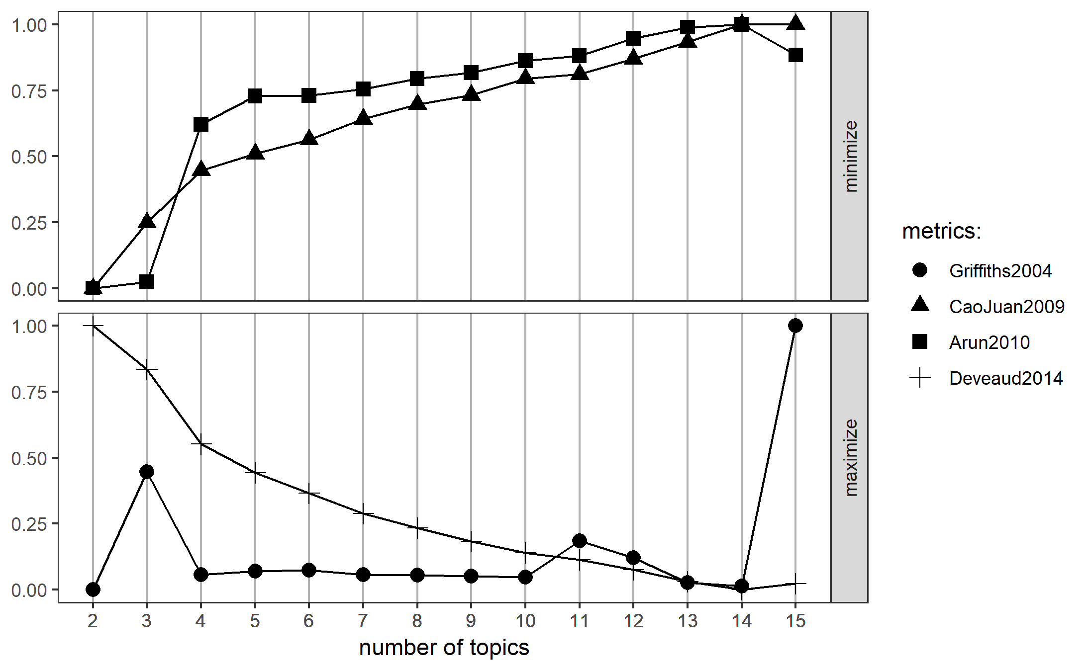
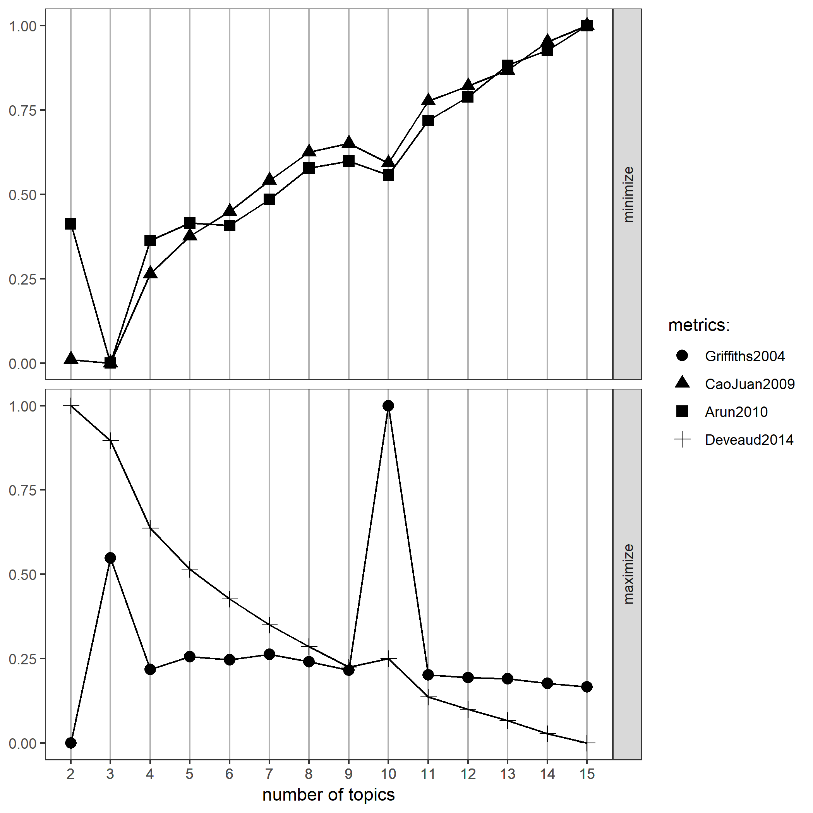
Analysis II: Topic modeling
After stratifying our sample of listings, we chose to understand how different topics appear in our corpus of text using the LDA Topic Model
Below, we see CV amongst our ’bad’ and ’good’ listings to determine the optimal number of topics to use in our model
’Bad’ Listings: LDA CV
‘Good’ Listings: LDA CV
Notes:
We chose LDA cause it’s easiest to implement
Here we can see optimal # of topics is 3 for bad listings
For "good" listings optimal number of topics is also 3. General behavior of the graphs is similar. It just can be noted that Griffiths's method proposes higher topic variability for "good" hosts.

Slide 11
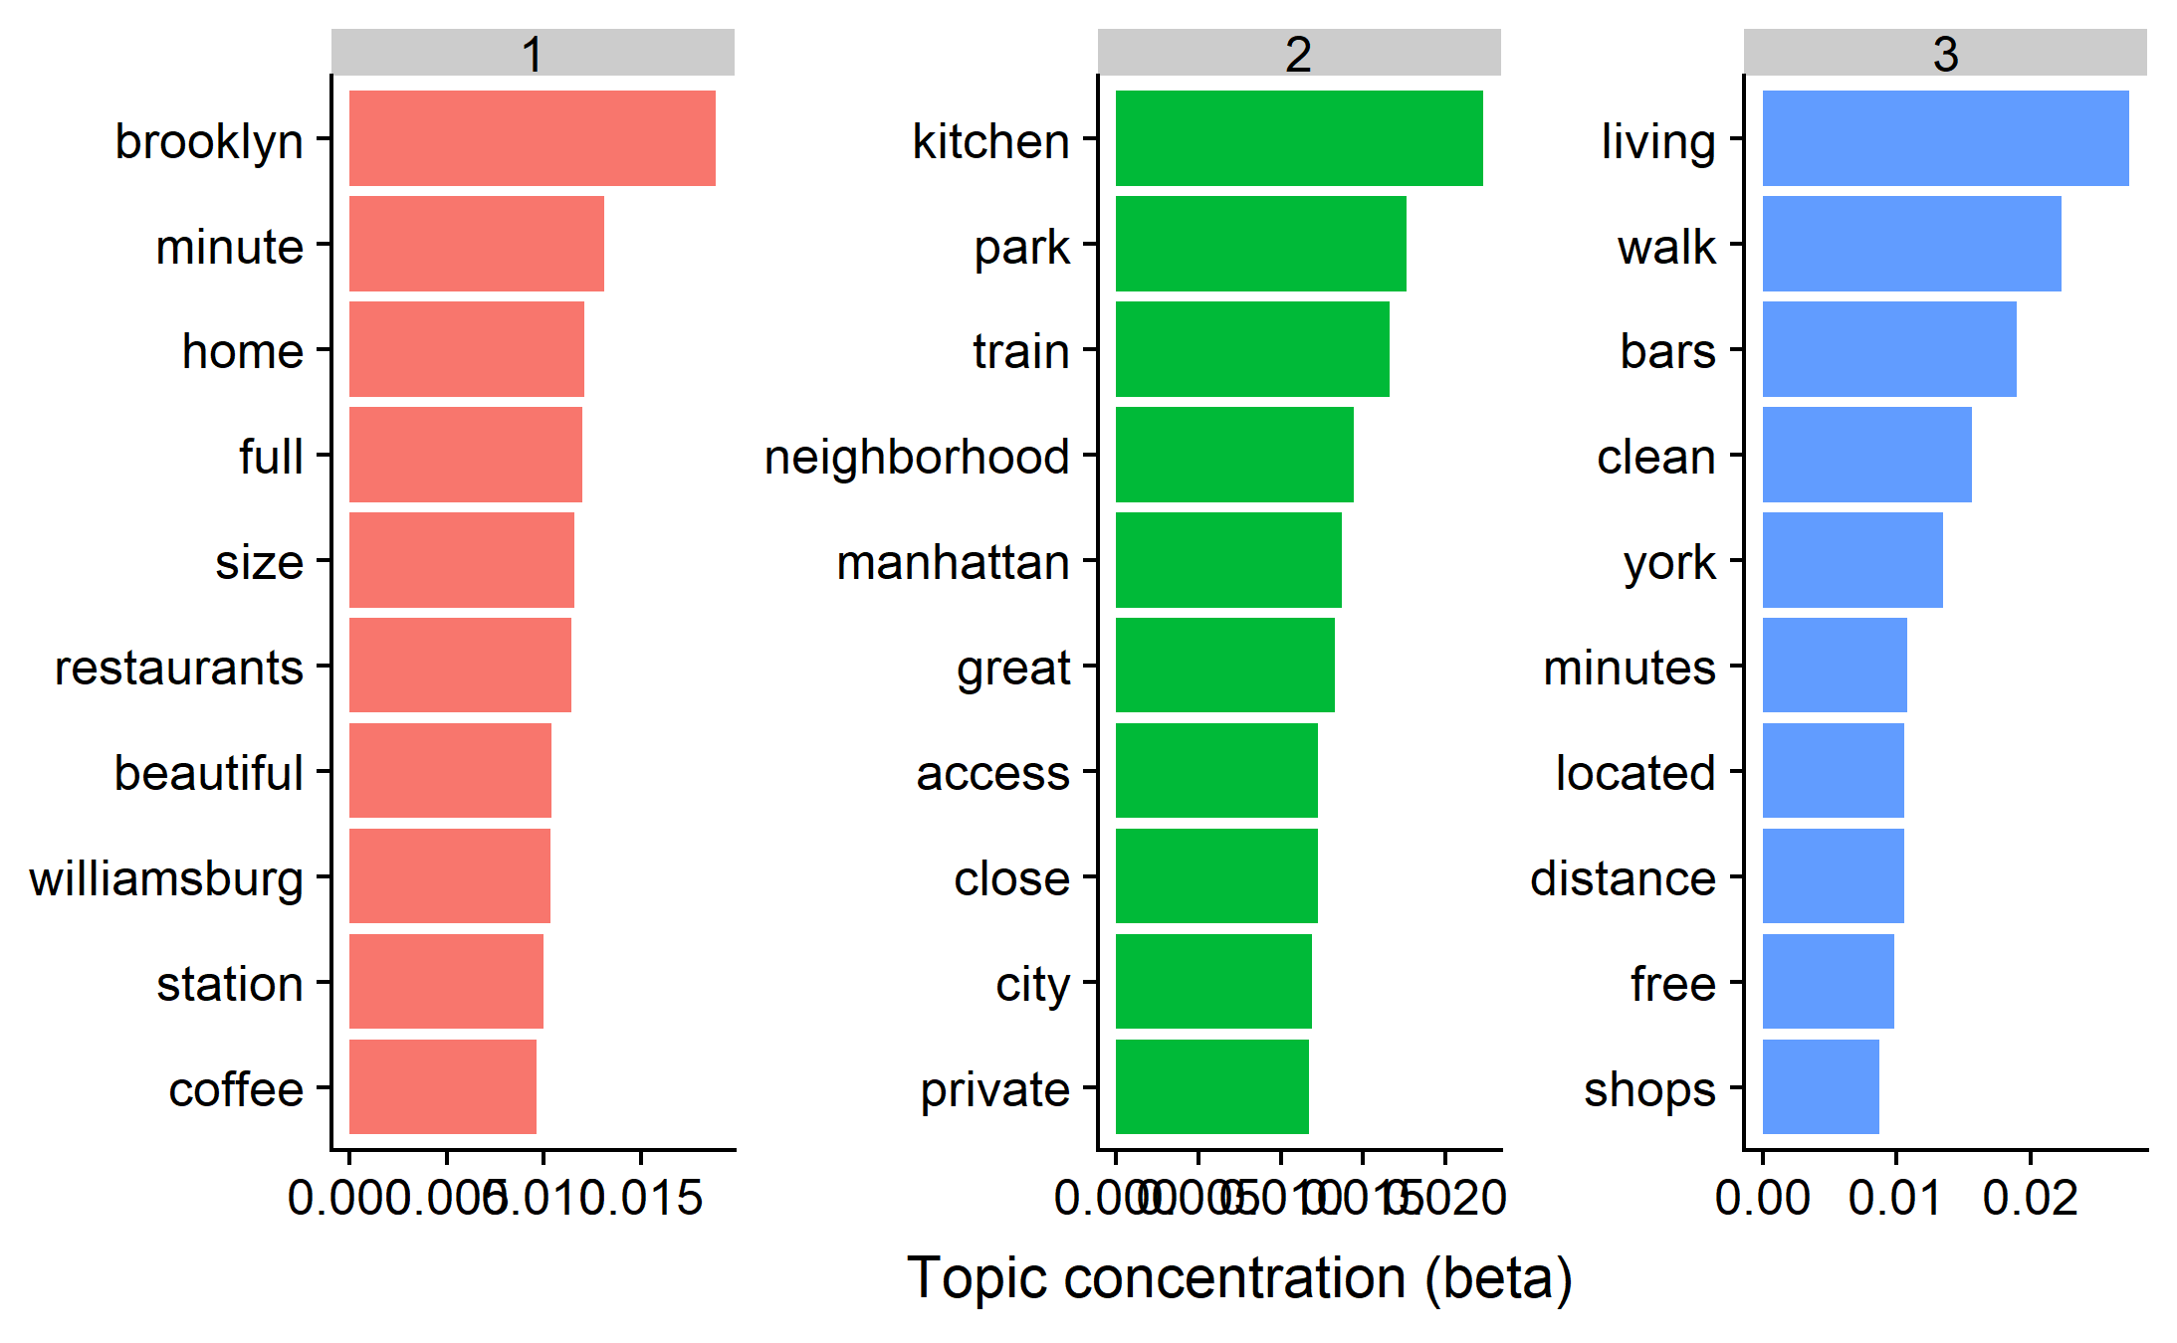
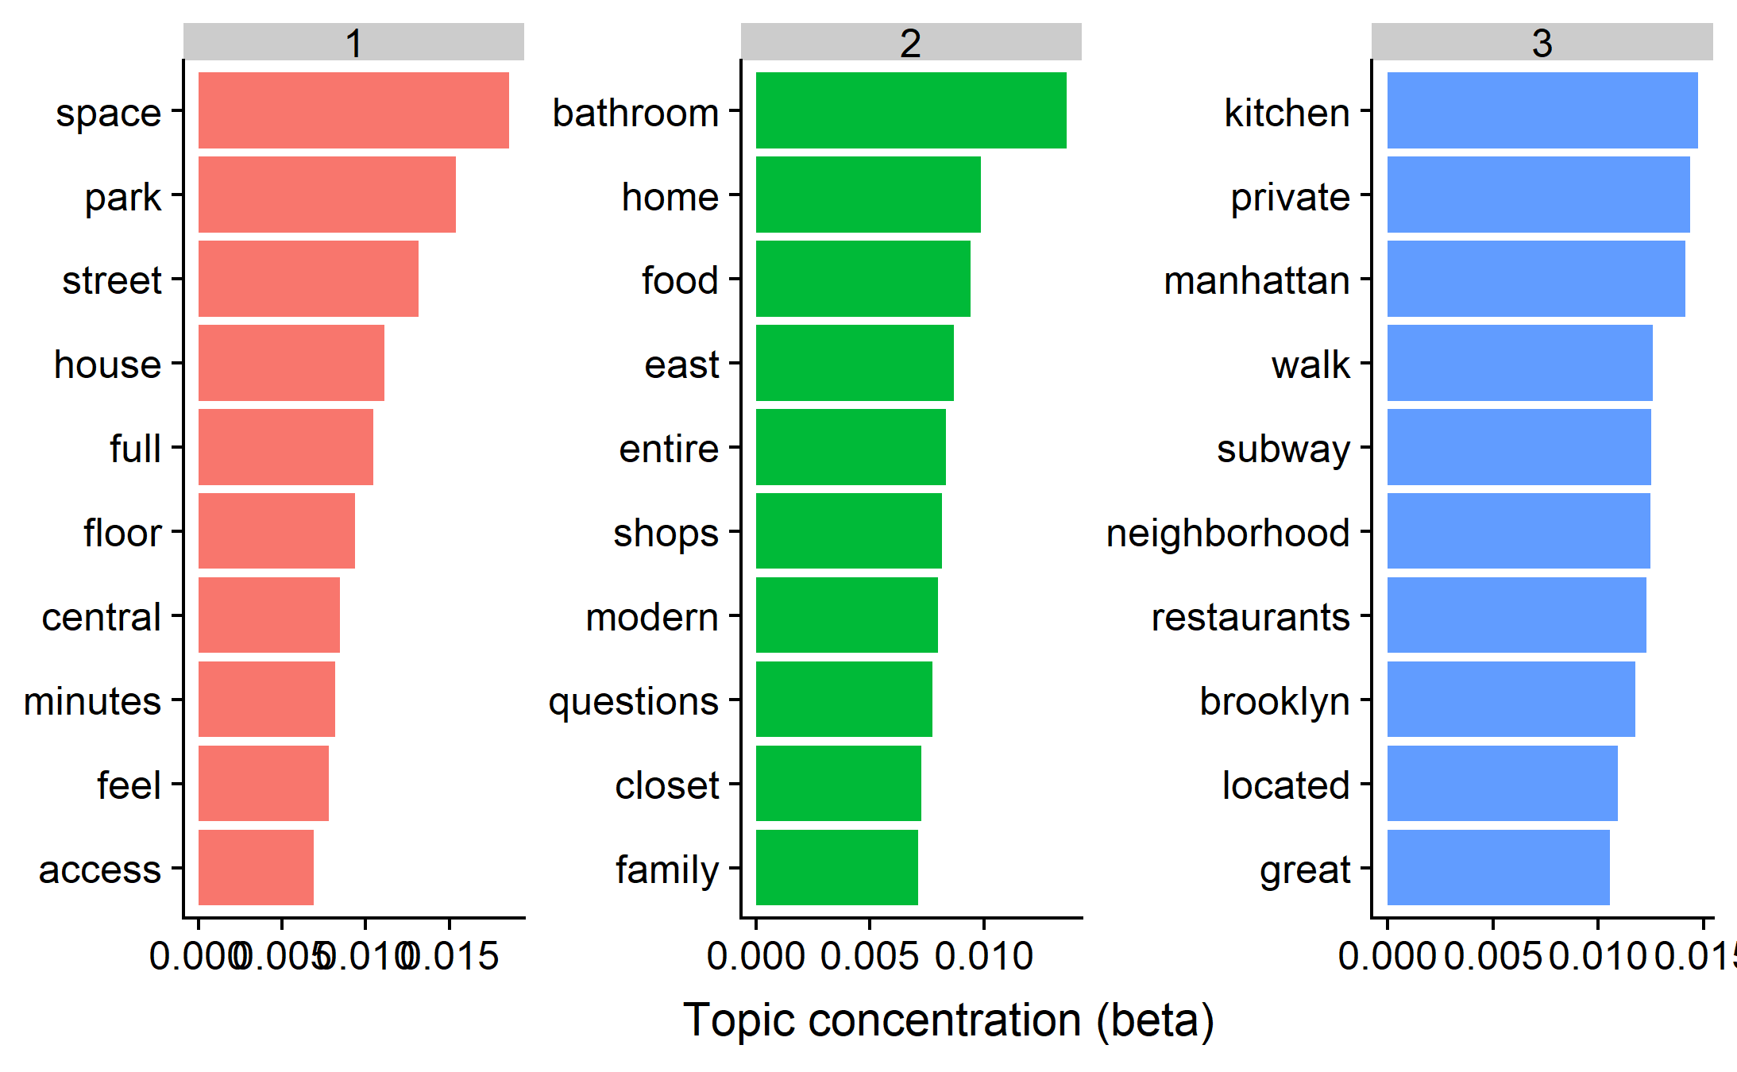
Analysis II: Topic modeling – Top 10 words per Topic
LDA – Top 10 words associated with
‘Bad’ listings
LDA – Top 10 words associated with
‘Good’ listings
Notes:
Takeaway – lots of intersections, but can point to certain missing elements in bad topics (i.e. family, feel, questions)
BAD
With a share of speculation, we can summarize least favorable topics: (1) featuring Williamsburg, Brooklyn with emphasis on size of apartment, proximity to the station, restaurants and coffeshops; (2) featuring Manhattan, with emphasis on kitchen and proximity to the city and the park (indeed, last popular thing on Manhattan is to cook); (3) walking distance to bars and shops also does not signal a successful description.
GOOD
Here, summary fo the topics may be the following: (1) combination on space, floor and convinient logistics; (2) apartment for family with storage space, featuring modern look and bathroom; (3) a fusion from "bad" scenarios: Manhattan and Brooklyn neighborhoods, restaurants and kitchen, as well as logistical benefits. Especially in he last topic, there is a noticable overlap between narratives from "good" and "bad" listings. We paid attention to several distinct features found only in "good" lsitings: * reference to how guests "feel";* reference to "family"* openness to "questions"."Bathroom" is a leading word for a "good topic", mentioning "kitchen" is controversial.

Slide 12
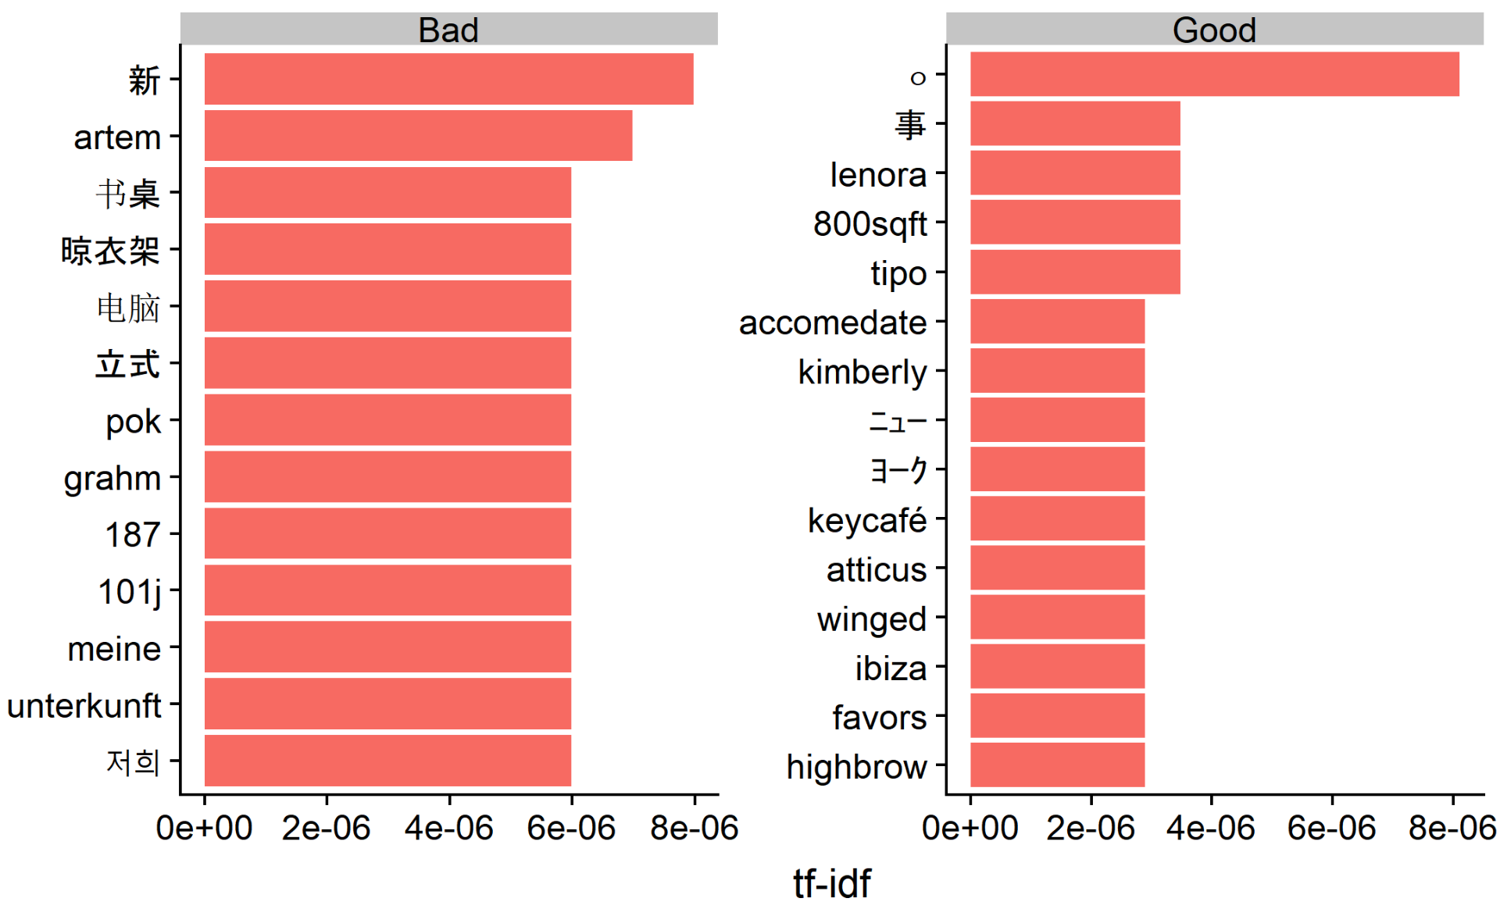
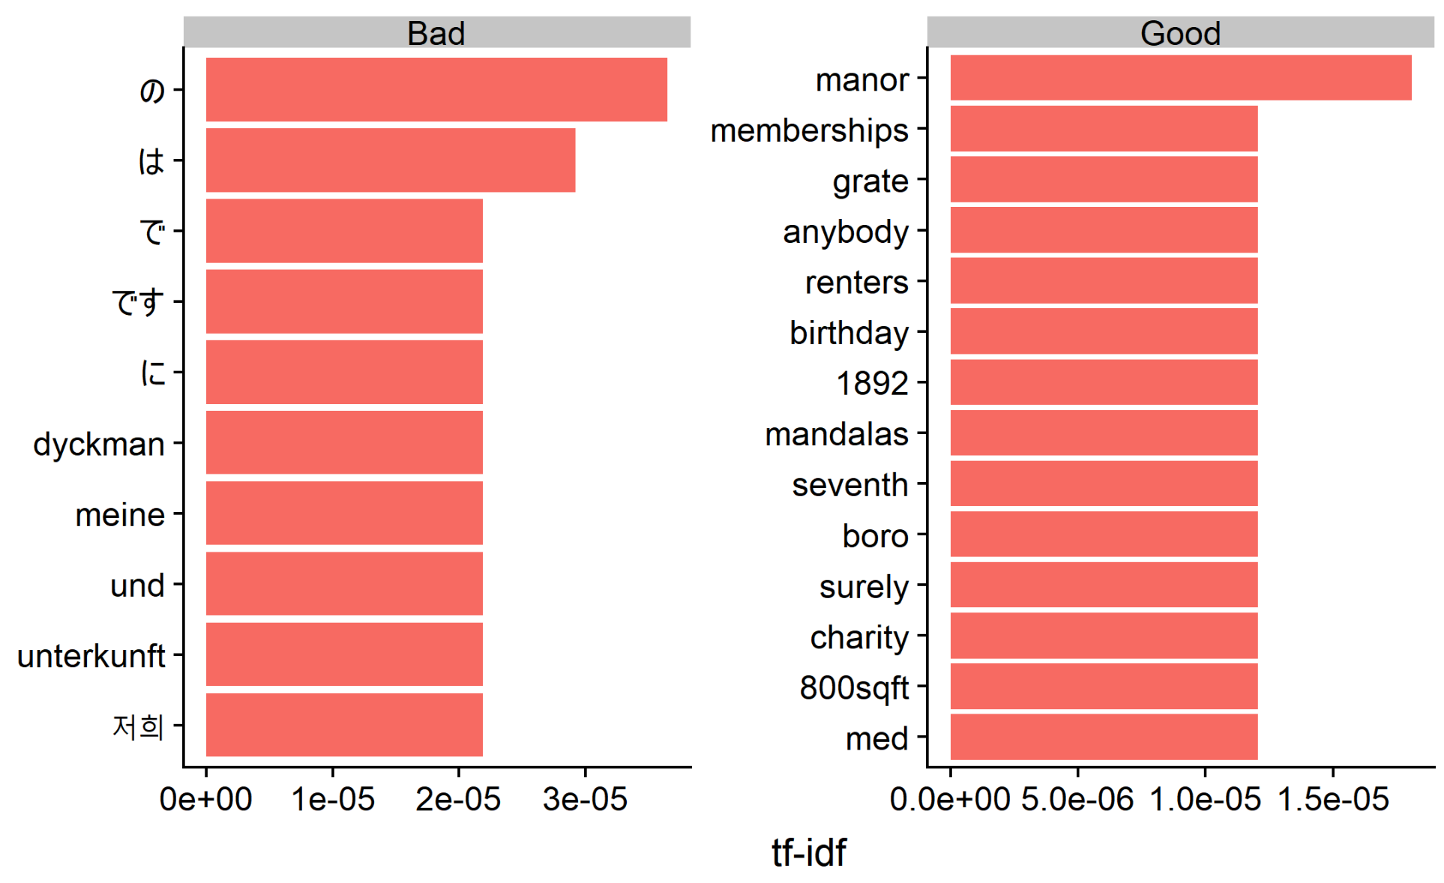
Analysis III: TF-IDF Vectorization
TF-IDF helps us to prescribe the below best practices in composing a listing:
Use proper English language grammar
Social associations (i.e. as membership and charity)
Grandiose qualifiers (such as "manor" instead of, say, "house").
Notes:
The first tf_idf = analysis on ALL of the data
The second – just the summary field

Slide 13

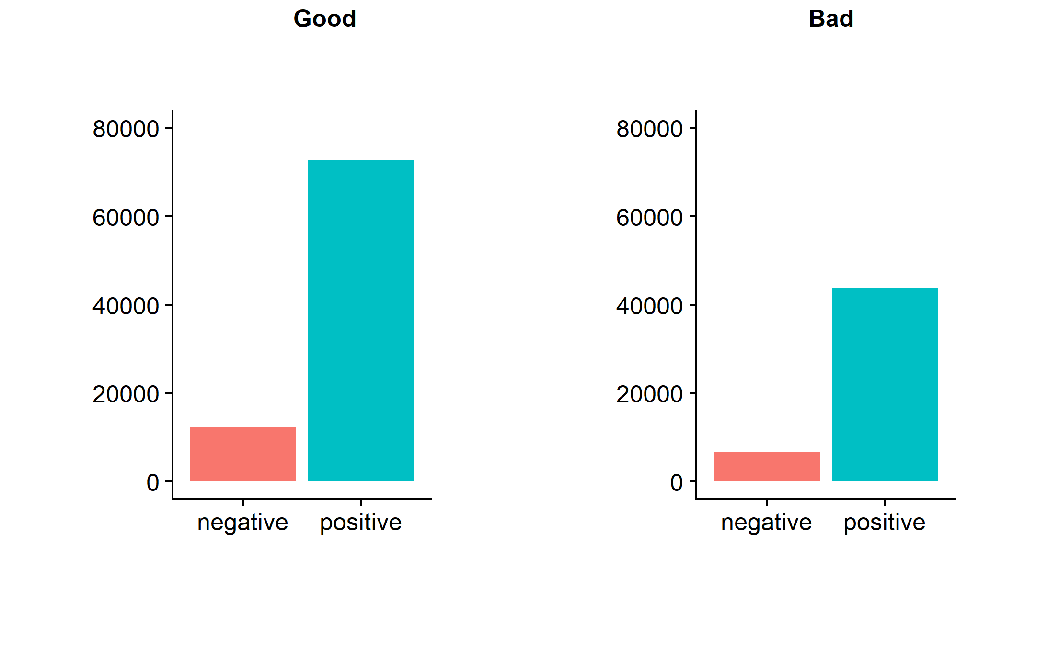
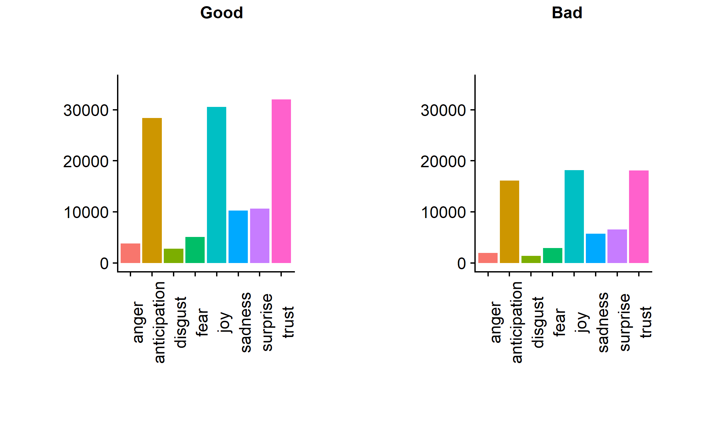
Analysis IV: Sentiment Analysis
Proportion of positive and negative words per each category of listing
Proportion of words per category divided amongst Plutchik’s wheel of emotions
Notes:
WE USED NRC AND PLUTCHIK libraries
Proportion of positive and negative sentiment for good and bad hosts is similar
Key takeaway here is that MORE EMOTION IS PRESENT, I.e. Longer Writeups, will be associated with better Airbnbs
Another perspective is to look at emotions with "bing" library, observing the same picture, but document-wise.

Slide 14
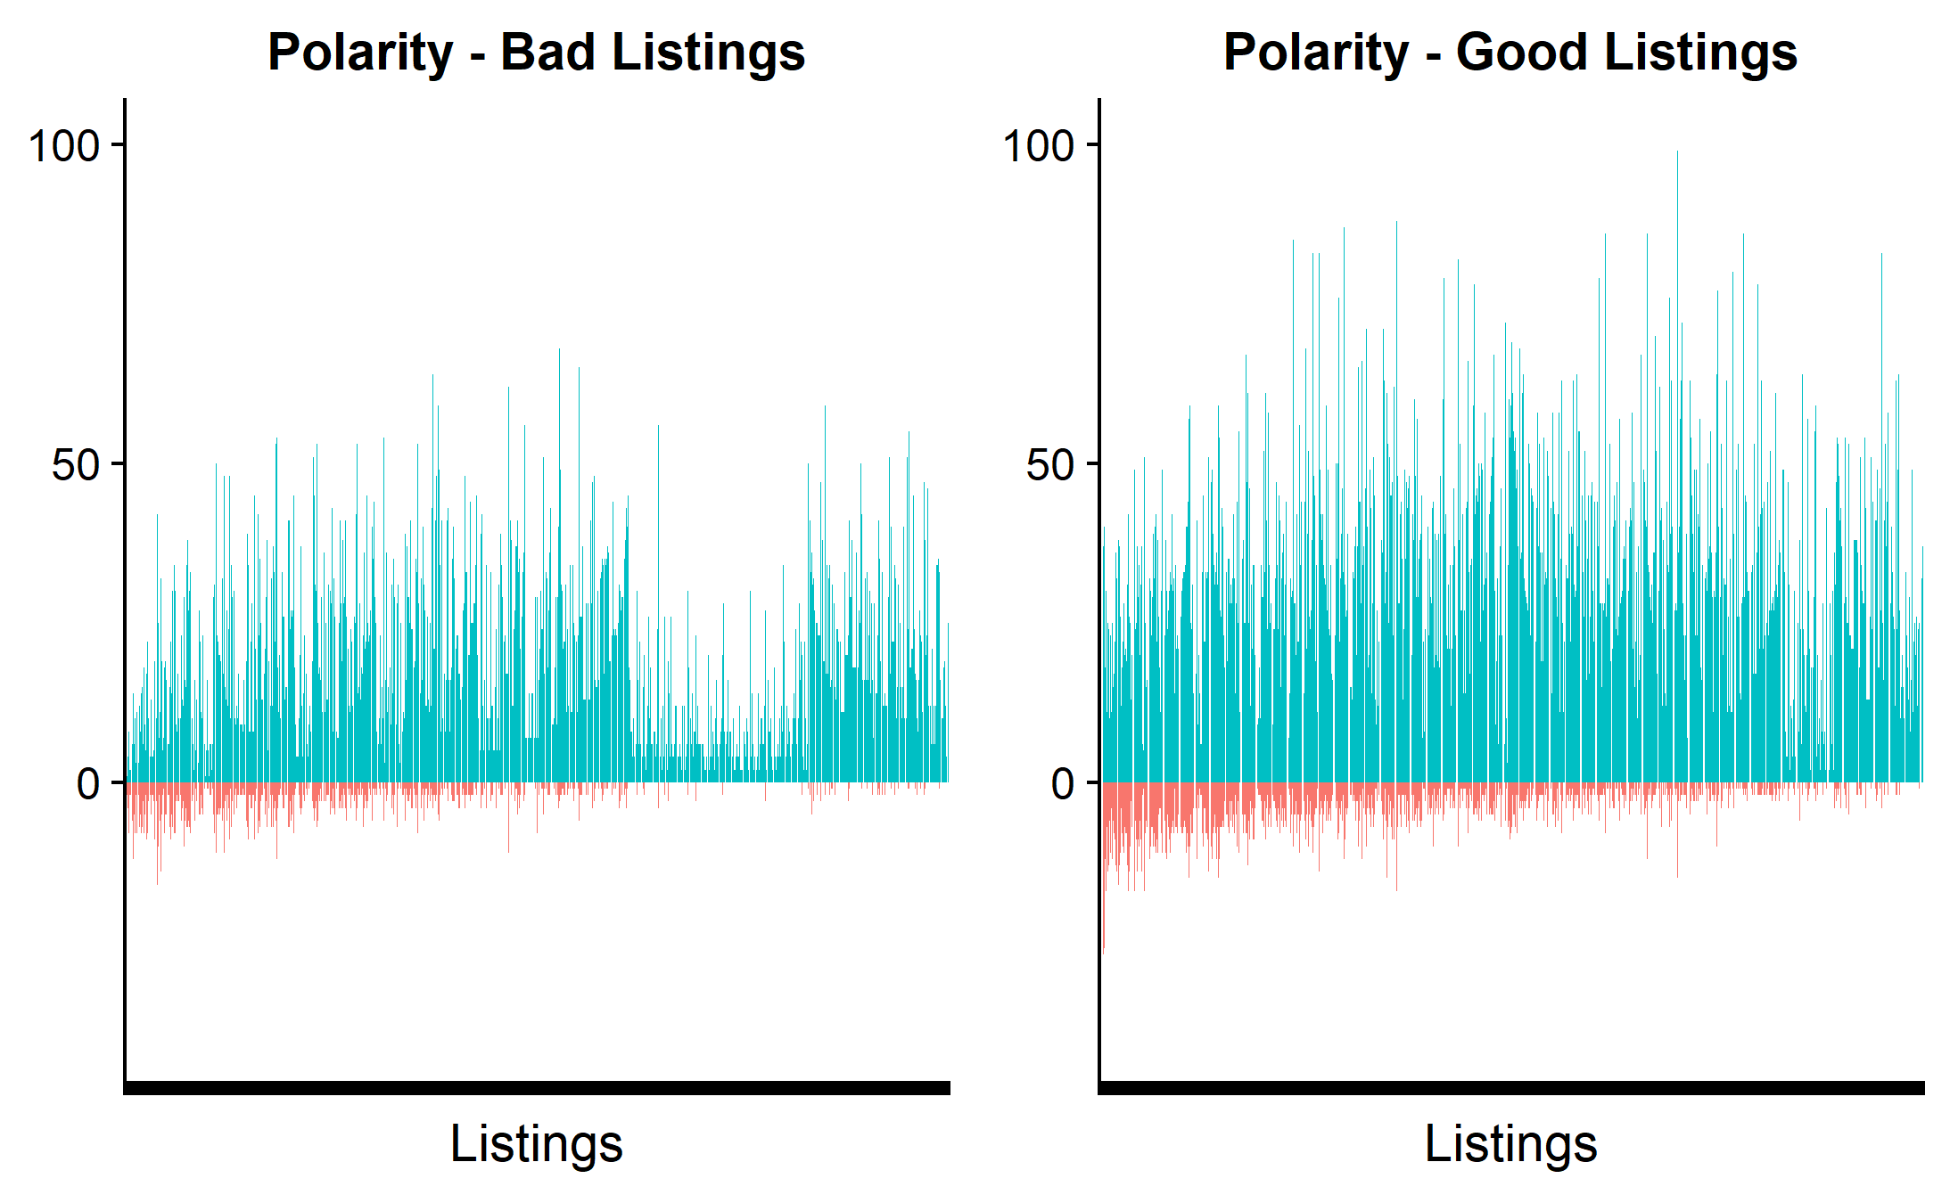
Analysis V: Polarity using ‘bing’ Library
The relative similarities view helps to confidently conclude that the amount of emotion, rather than the polarity of emotion, drives a successful listing
Notes:
The ’bing’ library analyzes polarity per document.

Slide 15

Conclusion
We conducted the analysis that offers tips on how to improve Airbnb performance for free - by writing a great description of your apartment. Here are the tips we discovered:
1. Write more across all textual categories, don't ignore optional fields.
Listing should contain between 2500 and 3500 words to be successful
2. Write a description of 1000 words.
3. Do not rely on exclamation marks to drive attention, this is not what best hosts do to differentiate.
4. If you want to skip a category, skip "about host category".
5. Make it personal! Display openness to "questions".
6. Use proper English grammar in answers.
7. Mention social affiliations (i.e. membership and charity) and grandiose adjectives (i.e. as "manor" instead of "house")
8. Add emotion by adding more textual descriptions, not by adding short and excessively "sweet" messages.

